Slide 1




Data Science Student Championship - South Zone
JOJU SHAJI
Designation

Slide 2

Data Understanding
Presenting a detailed overview of the data.
Important points:
The train dataset contained 134638 rows and 21 columns including the target column and test dataset wth 57722 rows and 21 columns
1)there are only 2 continuous features ,other features in the dataset can be considered as categorical ,the two continuous variables are right skewed or they have extreme values ,for both price ,security_deposit and area columns
2) since we are using ensampling model there is no worry about the outliers.
3)there are no null or missing values present.
4)the important point is the strong relation between price and security_deposit
Notes:
Learnings & how their approach can be applied to different use cases

Slide 3
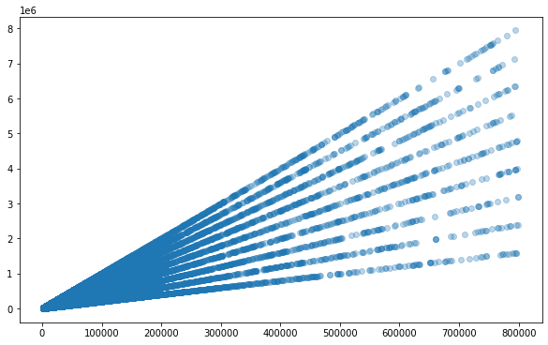
important graphs
security_deposit vs price
In this plot we can find some type of liner relation between the price and security_deposit in some order ,to find these relation we made new column “se_pr” ==security_deposit/price,
these column was a turning point.

Slide 4
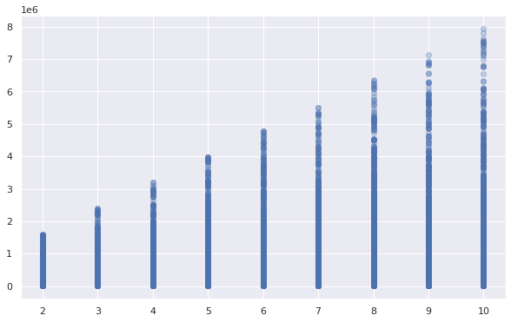
from the new column se_pr we came to a every important insight ,that all the values in se_pr column are whole number ranging from 2 to 10. Or we can say that if we know the security_deposit, then the house price will be security_deposit divided by 2,3…10 .
The minimum relation between security_depost between and price is 2 and maximum is 10.
security_deposit vs se_pr
from this plot we can say above some value of security_deposit the values of se_pr ranges from 3 to 10 . for eg if the security_deposit is > than 1592856 then the price and security_deposit will from 3 to 10 ,if security_deposit grater than 7136649 the price will be security_deposit/10 only .as such we can find 8 values of security_deposit

Slide 5
constructing new column named “int” based on the above plot,this is also a categorical column (no effect on the model) 2 represent all the rows with security_deposit below 1592856 ,3 represent rows with s_d below 2397975 like this the column int has 9 unique values ,this was also an important finding from this dataset.check the code file for more clarification.
Data Preparation
1)from data preparation we joined both test and train dataset by giving test[“price”]==”999”,firstly we converted the categorical
columns into numerical values , for eg in column “furnish_type” we convert it into 2,1,0 respectively.
2)the nominal categorical columns such as “city”, ”layout_type” ,”property_type” are encoded using label encoding.
3)the remaining categorical columns with yes or no values were converted into 1 and 0
4) only 3 additional columns were used along with given features for model building . they are “int”, “t_room” , ”luxary_scale” .
among these i mentioned the construction of column “int” above ,along with the plot
“t_room” = bathrooms+rooms in the building.
“luxary_scale” =
large.power_backup+large.washing_machine+large.air_conditioner+large['geyser/solar']+large['CCTV/security']+large.lift+
large.furnish_type
since we have converted all columns into numeric we can add the columns with 1 or 0 and furnish_type ,which gives the scale of luxury in each house
columns used for model bulding where ['room','layout_type','property_type','area','furnish_type','bathroom','city','parking_spaces','floor','pet_friendly',
'power_backup','washing_machine'’air_conditioner','geyser/solar','security_deposit','CCTV/security','lift','neighbourhood',
'luxary_scale','t_room','int']
at the initial modeling stage we used kfold ,but using kfold for this dataset was not ideal because ,the model was only trying to get the liner relationship between price and security_deposit column , so we decided to use the full data for training
and this approach give the best rmse.

Slide 6
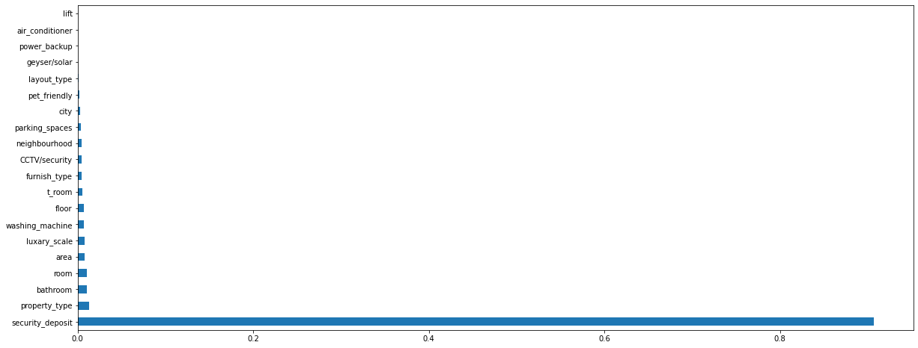
model
we used xgbRegressor model for this data,because it performed better than all the other models (without any hyperparameter tuning) the public leaderboard score without any hyperparameter tuning was 26813 (rmse) ,other xgb i tried lgbmregressor and randomforestregressor models ,but xgb give better score
the full training dataset was used for train the final model,but initially i used kfold which was overfitting somehow
in a real world we should always split the train set into validation dataset.
but i used “ early_stopping_rounds”=200 which will prevent the model from overfitting and “eval_set”
Extreme Gradient Boosting (XGBoost) : is an treebased algorithm which uses boosting ensampling technique. which is a used in regression predictive modeling.
we parameters where default. for more details about the algorithm https://xgboost.readthedocs.io/en/stable/tutorials/model.html
ideally i use kfold in every ml problem, but here the model was trying to find only some specific liner relationship between price and security_deposit because of the random kfold
so i used the full train dataset for model training.
as we seen in eda,in the mode alsol is overally dependent on the security_deposit column ,and other columns are dependent on the security_deposit column so we can use the security_deposit column to predict the price of the building. the above plot is of feature importance

Slide 7
trick using security_column for pridecting the house rent
use the model to predict the test set and saved in the newdataframe then add testdata’s “security_deposit” ,”int” and
“property_id columns into the new dataframe .
construct a new column for prediction dataframe ‘pro“ which is security_deposit / pridected_price.
since we know that the minimum house price and security_deposit relation will be 2 ,so if the pro value is less than 2.1 we will divide the corresponding security_deposit by 2 and it will be accurate house price ,save it to new column “new_price”
after this construct a new column to the dataframe “ rem” that is the reminder number of new_price.
then if the rem >0 and column “pro” is < 2 divide the security_deposit by 3 this will be the updated price saved into new column in the dataframe.
and also the maximum relation between deposit and price is 10 also if the security_deposit is > 7136649 then its 100% sure the price is security_deposit/10 this will be the updated price only for rows with security_deposit is > 7136649
likewise if the deposit is > 6348368 then the price will deposit divided by 10 or 9 we also find the price using the same technique.(look into the code for more clarification)
save this dataframe with updated price column.
#second phase of using deposit column.
let df be the preprocessed dataframe with both train and test data combained.
we construt columns “two”,three”,......”ten” it has values 1 or zero , if the corresponding security_deposit is divisibl by the number then it will be 1 or 0. for eg if a deposit is divisible by 2 then 1.
construct another column “tot_div” which is sum of above construct columns like “two”+”three”+.....+”ten”.
in this tot_div we can see value 1, which means that security_deposit is only one number divisible without reminder,that means that the price then will be deposit/that number

Slide 8
for rows with tot_div==1 we can find the correct house price by dividing the security_deposit by corresponding number. [for better understanding check code ,were it is described and executed correctly]
for rows with tot_div==2 ,we can say there are 2 numbers which can divide the deposit into whole number.
and rows with tot_div==2 and int >2 ,the number will not be 2 ,because for int>2 there is no relation between price and deposit below 3 ,so we ignore two column.
plz check the code for better clarification of the above idea
Important business insights coming from the models
the strong relation between target variable price and security_deposit.
the median rental price is 20856 ,means 50% lie below 20856,75% is 36014
most people need apartments for housing around 60%
layout type is BHK
we can say that all the other features are dependent on security_deposit column, these effect are also on the deposit column ,and rent is a specific linear relation between security_deposit.we can observe from the plot.
the column furnish_type has some effect on rent ,it the house is fully furnished then the price will be very high compare to unfurnished house.
and new column luxury_scale also has effect as the luxary_scale value increases price increases
if we know the security_deposit it is easier to get the rent price

Slide 9
Results and Recommendations
as mentioned the strong liner type relation between the target variable house rent price and security_deposit.
the median rental price is 20856 ,means 50% lie below 20856,75% is 36014
most people need apartments for housing around 60%
more houses are in the mumbai city
we can each popular localities in each cities
but in real world the rent is mostly dependent on the location of it ,but for this dataset i tried my best to use “locality” column by grouping it by each location and getting its agg mean value of price.
but when i used this feature the model was overfitting so i avoid that column.it is because of the noise in the dataset
if value of each locality is given then it will help the moel to predict the rent more accurately(recommendation)
we can use this model for deployment upon it we can write an additional code to perform extra work i have done to incerase the accuracy with the security_deposit column.
we can integrate this final model into any website.
we can use flask or django for deployment purpose

Slide 10
if the column security_deposit is not present then it will very difficult to predict the price ,
we can say that the column security_deposit act as a dataleakage feature in this dataset
dataleakage is not an ideal in ml problem dataset or it is the a big problem because the model will know very much about the target value directly .
in real world our model will be helpful for normal people who are looking to rent a house .our model give them a estimated value of the house rent according to each category ,and how the price will change

Slide 11
How can the dataset be helpful in solving real-world business problems in house rental spaces?
1)we can build a webapp or website that can give an estimated price of a rental house ,by building a predictive model.
we can build predictive model from this dataset as we seen above
we can integrate this model with a webapp and deploy it on the internet.
this will help people and rental owners ,
the person can find an estimation of rent price he needed to spent on the rental house he looking for.
<https://ikjlk.herokuapp.com/>
airbnb , oyo
webapp for houses under certain price.
2)we can get valuable business information such as
which type of rental house is most popular ,which areas especially.
what are specialty of the rental houses most people lookning for.
the rental price distribution in each type of hosuse ,and in each city.
check most popular localities in each city.
3)we can bulid a forecasting model if we have the time column.
check how seasons affect the price and taste of people for rental houses.
in some tourist areas the price increases in holidays ,weekands and vacation time.

Slide 12
On the basis of your analysis, can you generate some ideas which may be helpful in increasing the revenue of a house rental business?
1)the median value of rental price is 20856 ,means 50% lie below 20856,75% is 36014
more than 75% of the poplu look for houses with price less than 36014
so give more imp to houses fall under that price tag
2)more need apartment as property_type
init more apartments.
3)find the most popular localities in each city,
initiate more houses in those areas
4)find peoples popular choices in each locality.
5)find the range of rental price in each city,along with the facility
analysing this data we can get optimised price and facility.
6)use timeseries forecasting model

